Slide 1
Purpose of the course
§2.1 Introduction
An introduction to the organization and design of computers – principles, techniques, issues…
Prerequisites:
Assembly programming (the view of computer (processor) at the register’s level)
Basic knowledge of Boolean algebra and logic circuits – AND/OR gates, and Boolean functions performed by them

Slide 2
Purpose of the course
§2.1 Introduction
It is a common practice to discuss the principles of computer HW/SW design based on a specific, existing computer structure
The underlying computer this course is based on is called MIPS
Microprocessor without Interlocked Pipelined Stages
Millions of Instructions Per Second

Slide 3
Purpose of the course
§2.1 Introduction
The instruction set of a computer describes how the computer functions at the lowest (register/memory) level
We start by examining the instruction set of MIPS
Idea – We want to design a processor. The first thing to do is to specify the computer’s operations, i.e. what this computer can do

Slide 4
Chapter 2
Instructions: Language of the Computer

Slide 5
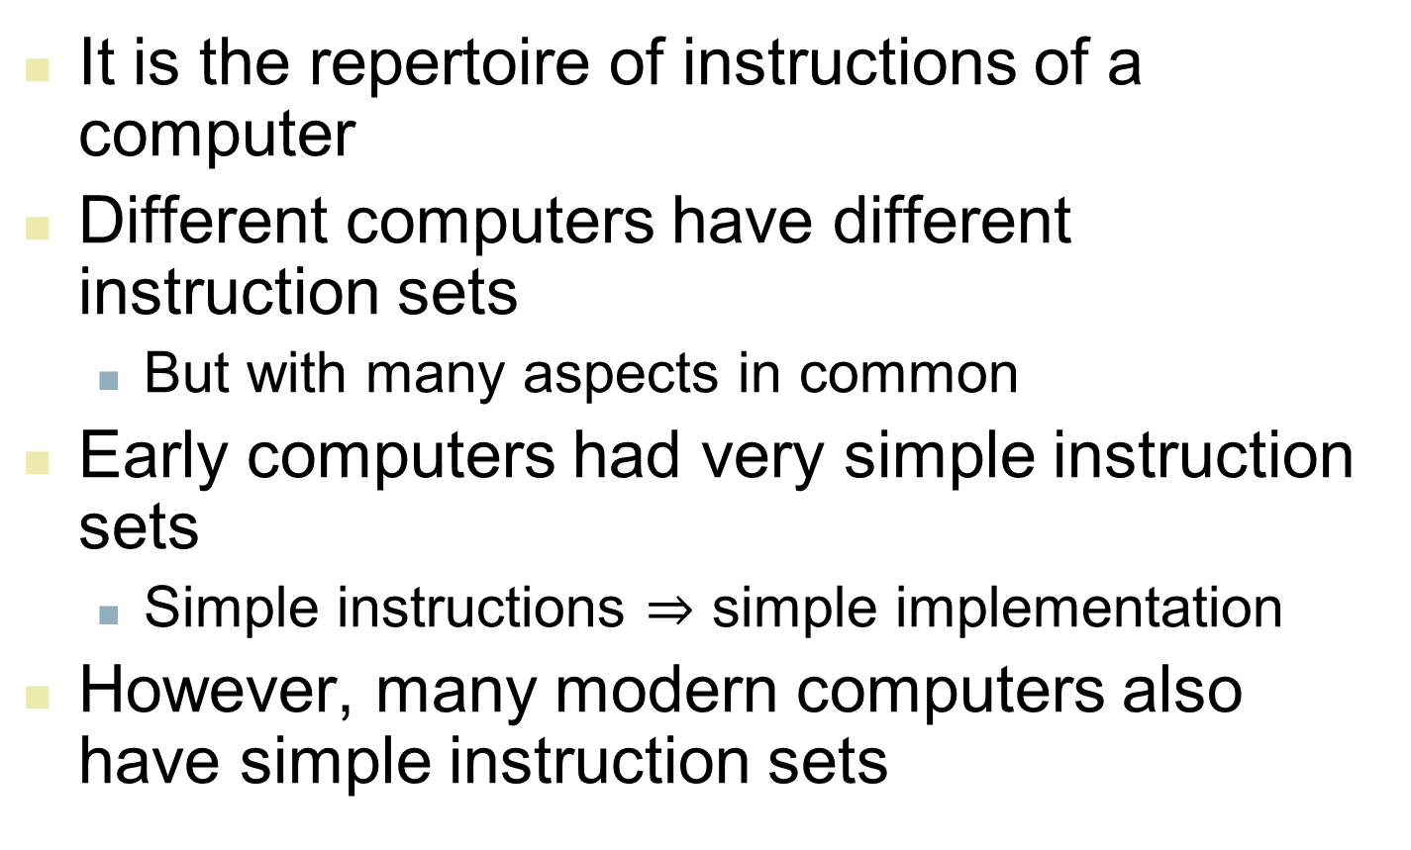
Instruction Set
§2.1 Introduction
It is the repertoire of instructions of a computer
Different computers have different instruction sets
But with many aspects in common
Early computers had very simple instruction sets
Simple instructions $⇒$ simple implementation
However, many modern computers also have simple instruction sets

Slide 6
Instruction Set
§2.1 Introduction
Two computer design paradigms
– CISC vs. RISC
CISC: Complex Instruction Set Computer
Powerful, complex instructions, shorter programs, but need more complex hardware
RISC: Reduced Instruction Set Computer
Smaller, simple instruction set, need more instructions for complex operations
MIPS belongs to the RISC category

Slide 7
The MIPS Instruction Set
Used as the example throughout this course
Stanford MIPS commercialized by MIPS Technologies (www.mips.com)
Typical of many modern ISAs (Industry Standard Architecture)

Slide 9
Arithmetic Operations
add/subtract, three operands
Two sources and one destination
add a, b, c # a gets b + c
where a,b,c are all registers in the processor
All arithmetic operations have the same form (sub a, b, c; mul a, b, c …)
Favors regularity
§2.2 Operations of the Computer Hardware

Slide 10
Arithmetic Operations
Design Principle 1: Simplicity favors regularity
Regularity/uniformity makes hardware implementation simpler
Simplicity enables higher performance at lower cost
§2.2 Operations of the Computer Hardware

Slide 11
Arithmetic Example
Most programmers write programs in high-level languages, such as Java or C
Example C code:
f = (g + h) - (i + j);
Compiled MIPS code:
add t0, g, h # temp t0 = g + h add t1, i, j # temp t1 = i + j sub f, t0, t1 # f = t0 - t1

Slide 12
Register Operands
In computers, arithmetic instructions use registers to hold operands
MIPS has a 32 × 32-bit register set
Used for holding data that are currently processed
Registers are numbered from 0 to 31
32-bit data called a “word”
We can assign names to registers
$t0, $t1, …, $t9 for temporary values (10 registers)
$s0, $s1, …, $s7 for saved variables (8 registers)
Design Principle 2: Smaller is faster
c.f. main memory: millions of locations
§2.3 Operands of the Computer Hardware
Notes:
So, the total size of the register file =
32 \text{ registers} \times 32 \text{ bits} = 1024 \text{ bits (128 bytes)}

Slide 13
Register Operand Example
C code:
f = (g + h) - (i + j);
f, g, h, i, j $s0, $s1, $s2, $s3, $s4
variables registers
Compiled MIPS code:
add $t0, $s1, $s2 add $t1, $s3, $s4 sub $s0, $t0, $t1

Slide 14
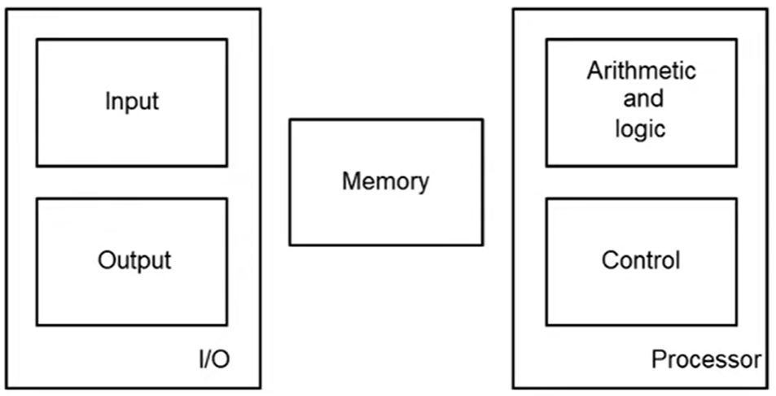
Memory Operands
Main memory used for composite and large amount of data
Arrays, structures (Java objects), dynamic data
Registers
in here

Slide 15
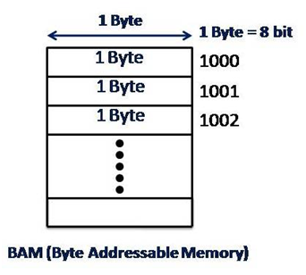
Memory Operands
To apply arithmetic operations, need to
Load values from memory into registers (g,h,i,j)
Store result from register to memory (f)
Memory is byte-addressed
Each address holds an 8-bit byte
Words are aligned in memory
Each word occupies 4 consecutive addresses
So a word address must be a multiple of 4

Slide 16
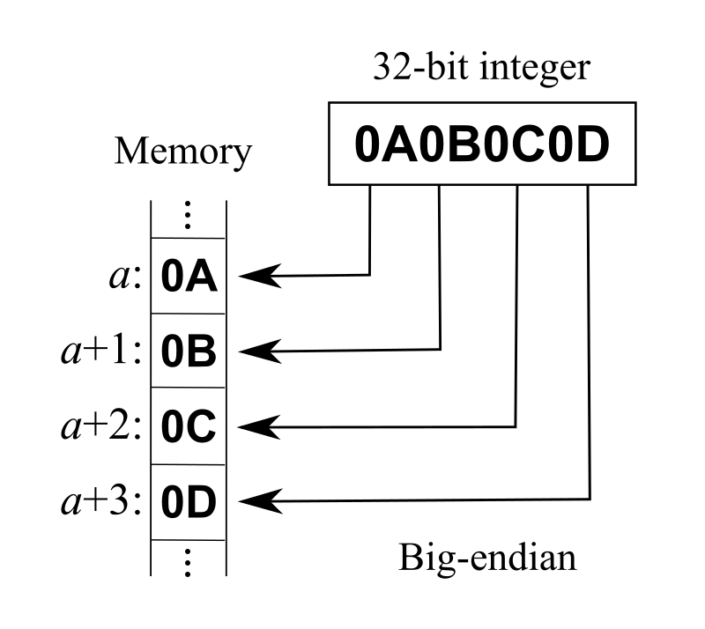
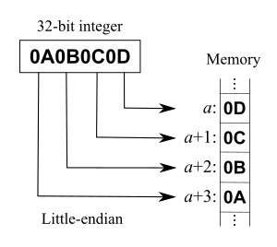
Memory Operands
MIPS uses “Big Endian” convention
Most-significant byte at least address of a word
c.f. Little Endian: least-significant byte at least address

Slide 17
Registers vs. Memory
Registers are much faster to access and operate on than memory
Operating on memory data requires
load-word (lw) and store-word (sw)

Slide 18
Memory Operand Example 1
C code:
g = h + A[8];
g in $s1, h in $s2, base address of A in $s3
Compiled MIPS code:
Index [8] requires offset of 32
4 bytes per word
lw $t0, 32($s3) # load word add $s1, $s2, $t0
in memory
offset
base register

Slide 19
Memory Operand Example 2
C code:
A[12] = h + A[8];
h in $s2, base address of A in $s3
Compiled MIPS code:
Index [8] requires offset of 32
Index [12] requires offset of 48
lw $t0, 32($s3) # load word add $t0, $s2, $t0 sw $t0, 48($s3) # store word
in memory

Slide 20
Registers vs. Memory
Compiler should use registers for variables as much as possible
Only spill to memory for less frequently used variables
Register optimization is important!
Out of the range of this course

Slide 21
Immediate Operands
Constant data specified in an instruction
add immediate
addi $s3, $s3, 4 # 4 is part of instruction
No “subtract immediate” instruction
Just use a negative constant
addi $s2, $s1, -1 # minus 1
addi $s2, $s1, -7 # minus 7
Design Principle 3: Make the common case fast
Small constants are common in programming
Immediate operand avoids a load instruction

Slide 22
The Constant Zero
MIPS register 0 ($zero) is the constant 0
Fixed value, always contains 0
Cannot be overwritten
Useful for some commonplace operations
E.g., move between registers
add $t2, $s1, $zero
Equivalent to
move $t2, $s1

Slide 24
Unsigned Binary Integers
Given an n-bit binary number
b_{n-1}b_{n-2}… b₁b₀
Its decimal value x
x = b_{n-1}×2^{n-1} + b_{n-2}×2^{n-2} +… + b₁×2¹ + b₀×2⁰
§2.4 Signed and Unsigned Numbers
Range: 0 to +2^{n} – 1
Example:
n = 4; Range: 0 to 15 (0000 – 1111)
n = 5; Range: 0 to 31 (00000 – 11111)

Slide 25
Unsigned Binary Integers
MIPS Example
0000 0000 0000 0000 0000 0000 0000 1011₂ = 0×2³¹ + 0×2³⁰ + … + 1×2³ + 0×2² +1×2¹ +1×2⁰ = 0 + 0 + … + 8 + 0 +2 +1 = 11₁₀
Using 32 bits
0 to +4,294,967,295
(00…0000 to 11…1111)
§2.4 Signed and Unsigned Numbers

Slide 26
2s-Complement Signed Integers
Given an n-bit binary number
b_{n-1}b_{n-2}… b₁b₀
Its decimal value
x = −b_{n-1}×2^{n-1} + b_{n-2}×2^{n-2} +… + b₁×2¹ + b₀×2⁰
Range: −2^{n-1} to +2^{n-1} − 1
Example:
n = 4; Range: -8 to +7 (1000 – 0111)
n = 5; Range: -16 to +15 (10000 – 01111)

Slide 27
2s-Complement Signed Integers
MIPS Example
1111 1111 1111 1111 1111 1111 1111 1100₂ = −1×2³¹ + 1×2³⁰ + … + 1×2² +0×2¹ + 0×2⁰ = −2,147,483,648 + 2,147,483,644 = −4₁₀
Using 32 bits
−2,147,483,648 to +2,147,483,647
(100…000 to 0111…111)

Slide 28
2s-Complement Signed Integers
Bit 31 is used as sign-bit
1: the number is negative
0: the number is non-negative (positive or zero)
+2^{n – 1} can’t be represented
Non-negative numbers have the same unsigned and 2s-complement representation
Some special numbers
0: 0000 0000 … 0000
–1: 1111 1111 … 1111
Most-negative: 1000 0000 … 0000 (−2^{n – 1})
Most-positive: 0111 1111 … 1111 (+2^{n – 1} − 1)

Slide 29
Signed Negation
Step 1: Complement all bits
Step 2: Add 1
Complement means 1 → 0, 0 → 1 (flip)
Example: negate +2
+2 = 0000 0000 … 0010₂
−2 = 1111 1111 … 1101₂ + 1 = 1111 1111 … 1110₂

Slide 30
Sign Extension
Representing a number using more bits
Have to preserve the original numeric value
In MIPS instruction set
addi: need to extend immediate value
lb, lh: load-byte (8-bits), load-half (16-bits)
need to extend loaded byte/halfword
beq, bne: need to extend the (jump) displacement
Replicate the sign bit to the left
c.f. unsigned values: extend with 0s
Examples: 8-bit to 16-bit
+2: 0000 0010 => 0000 0000 0000 0010
–2: 1111 1110 => 1111 1111 1111 1110

Slide 32
Representing Instructions
Instructions are also encoded in binary bits
Called machine code
MIPS instructions
Encoded as 32-bit instruction words
Try to encode operation code (opcode), register numbers, constants… in just a few formats
Register numbers (IDs):
From register #0 to register #31
$t0 – $t7 are registers 8 – 15
$t8 – $t9 are registers 24 – 25
$s0 – $s7 are registers 16 – 23
§2.5 Representing Instructions in the Computer

Slide 33
MIPS R-format Instructions
op
rs
rt
rd
shamt
funct
6 bits
5 bits
5 bits
5 bits
5 bits
6 bits
Instruction fields
op: operation code (opcode)
rs: first source register number
rt: second source register number
rd: destination register number
shamt: shift amount (not used, 00000 for now)
funct: function code (extends opcode)

Slide 34
R-format Example
op
rs
rt
rd
shamt
funct
6 bits
5 bits
5 bits
5 bits
5 bits
6 bits
add $t0, $s1, $s2
special
$s1
$s2
$t0
0
add
0
17
18
8
0
32
000000
10001
10010
01000
00000
100000
00000010001100100100000000100000₂ = 02324020₁₆
0 2 3 2 4 0 2 0 ₁₆

Slide 35
Hexadecimal
Base 16
Compact representation of bit strings
4 bits per hex digit
0 | 0000 | 4 | 0100 | 8 | 1000 | C | 1100
1 | 0001 | 5 | 0101 | 9 | 1001 | D | 1101
2 | 0010 | 6 | 0110 | A | 1010 | E | 1110
3 | 0011 | 7 | 0111 | B | 1011 | F | 1111
Example: ECA8 6420
1110 1100 1010 1000 0110 0100 0010 0000

Slide 36
MIPS I-format Instructions
op
rs
rt
constant or address
6 bits
5 bits
5 bits
16 bits
Immediate arithmetic – addi
load/store – lw/sw
rt: destination or source register number
Constant: –2¹⁵ to +2¹⁵ – 1 (-32,768 to +32767)
Address: offset added to base address in rs
Example: addi $t0, $s1, 4
Example: lw $t1, 100($s1)

Slide 37
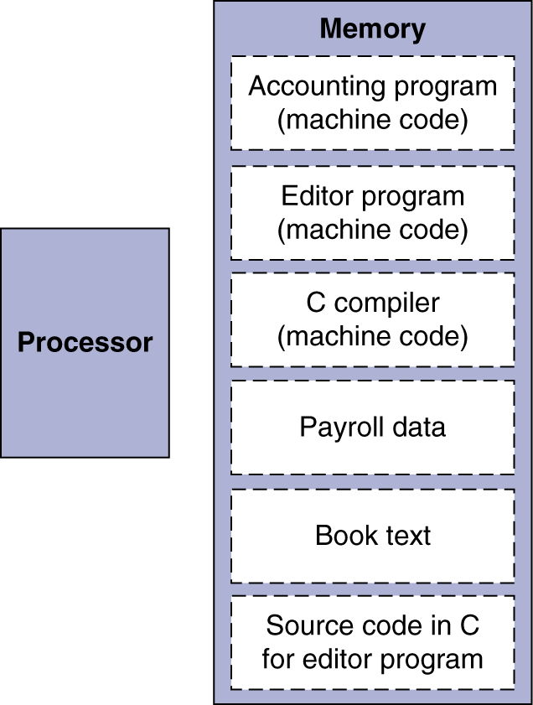
Stored Program Computers
The BIG Picture
Instructions are represented in binary bits, just like data
Instructions and data both stored in memory
Programs can operate on programs
e.g., compilers, linkers, …
Binary compatibility allows compiled programs to work on different (but compatible) computers

Slide 38
Shift Operations
op
rs
rt
rd
shamt
funct
6 bits
5 bits
5 bits
5 bits
5 bits
6 bits
Examples:
Sll t2, s0, 8
srl t3, s1, 4

Slide 39
Shift Operations
op
rs
rt
rd
shamt
funct
6 bits
5 bits
5 bits
5 bits
5 bits
6 bits
shamt: how many positions to shift
Shift left logical
Shift left, and fill with 0 bits (on right)
sll by i bits = multiplies by 2^{i}
Shift right logical
Shift right, and fill with 0 bits (on left)
srl by i bits = divides by 2^{i} (unsigned only)

Slide 40
AND Operations
Useful to mask bits in a word
0 & x = 0; 1 & x = x
Select some bits, clear others to 0
and $t0, $t1, $t2
(select the 4 shaded bits in $t2)
$t2
0000 0000 0000 0000 0000 1101 1100 0000
$t1
0000 0000 0000 0000 0011 1100 0000 0000
(selector register)
$t0
0000 0000 0000 0000 0000 1100 0000 0000

Slide 41
OR Operations
Useful to include bits in a word
0 | x = x; 1 | x = 1
Set some bits to 1, leave others unchanged
or $t0, $t1, $t2
$t2
0000 0000 0000 0000 0000 1101 1100 0000
$t1
0000 0000 0000 0000 0011 1100 0000 0000
(setter register)
$t0
0000 0000 0000 0000 0011 1101 1100 0000

Slide 42
NOT Operations
Useful to invert (flip) bits in a word
Change 0 → 1, and 1 → 0
MIPS has 3-operand NOR instruction
a NOR b == NOT ( a OR b )
nor $t0, $t1, $zero
($t0 ← NOT($t1))
Register 0: always read as zero
$t1
0000 0000 0000 0000 0011 1100 0000 0000
$t0
1111 1111 1111 1111 1100 0011 1111 1111

Slide 44
Stored Program Computers
The BIG Picture
Instructions are represented in binary bits, just like data
Instructions and data both stored in memory
Programs can operate on programs
e.g., compilers, linkers, …
Binary compatibility allows compiled programs to work on different (but compatible) computers

Slide 45
Instruction Formats
R-format: Arithmetic, logical, shift
I-format: immediate, load/store
op
rs
rt
rd
shamt
funct
6 bits
5 bits
5 bits
5 bits
5 bits
6 bits
op
rs
rt
constant or address
6 bits
5 bits
5 bits
16 bits

Slide 46
Conditional Operations
Branch to a labeled instruction if some condition is true; otherwise, continue sequentially
beq rs, rt, L1
if (rs == rt) branch to instruction labeled L1;
bne rs, rt, L1
if (rs != rt) branch to instruction labeled L1;
j L1
unconditional jump to instruction labeled L1
§2.7 Instructions for Making Decisions

Slide 47
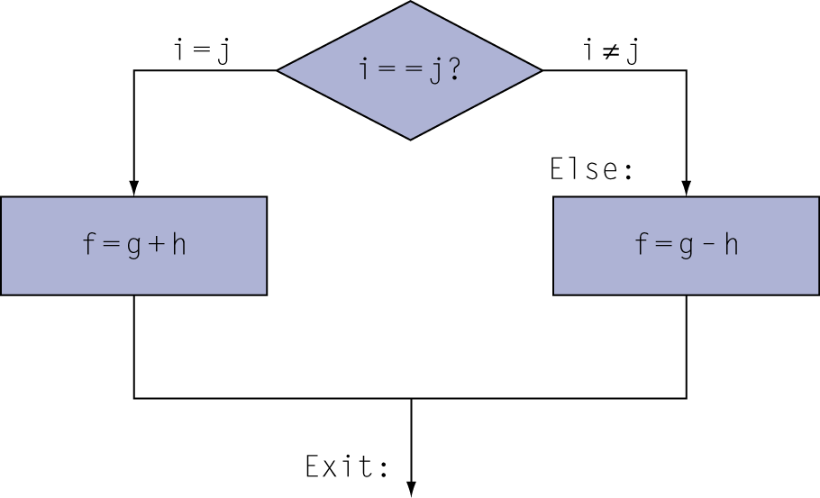
Compiling If Statements
C code:
if (i==j) f = g+h; else f = g-h;
f, g, … in $s0, $s1, …
Compiled MIPS code:
bne $s3, $s4, Else # i=s3, j=s4
add $s0, $s1, $s2 # f = g+h
j Exit
Else: sub $s0, $s1, $s2 # f = g-h
Exit: …
Assembler calculates addresses

Slide 48
Compiling Loop Statements
C code:
while (save[i] == k) i++;
Counting the number of “k” in array save[]
i = $s3, k = $s5, address of save = $s6
Compiled MIPS code:
Loop: sll $t1, $s3, 2 # t1 ← i*4 add $t1, $t1, $s6 lw $t0, 0($t1) bne $t0, $s5, Exit addi $s3, $s3, 1 # i += 1 j Loop Exit: …

Slide 49
Basic Blocks
A basic block is a sequence of instructions with
No embedded branches (except at end)
No branch targets (except at beginning)
A compiler identifies basic blocks for optimization
An advanced processor can accelerate execution of basic blocks

Slide 50
More Conditional Operations
Set a register to 1 if a condition is true; otherwise, set to 0
slt rd, rs, rt
if (rs < rt) rd = 1; else rd = 0;
slti rt, rs, const
if (rs < const) rt = 1; else rt = 0;
Use in combination with beq, bne
slt $t0, $s1, $s2 # if ($s1 < $s2) bne $t0, $zero, L # branch to L

Slide 51
Branch Instruction Design
Why not blt, bge, etc?
Hardware for <, ≥, … slower than =, ≠
<, ≥ combining with branch involves more work per instruction, requiring a slower clock
All instructions penalized (since clock is used by all instructions)
beq and bne are the common case
=, ≠ combining with branch happen to result in a quicker hardware
A good example of design compromise

Slide 52
Signed vs. Unsigned
slt, slti are signed comparison
Unsigned comparison: sltu, sltui
Example
$s0 = 1111 1111 1111 1111 1111 1111 1111 1111
$s1 = 0000 0000 0000 0000 0000 0000 0000 0001
slt $t0, $s0, $s1 # signed
–1 < +1 ⇒ $t0 = 1
sltu $t0, $s0, $s1 # unsigned
+4,294,967,295 > +1 ⇒ $t0 = 0

Slide 54
Procedure (Method) Calling
proc(x, y, z);
……
Steps happening:
Place parameters (x, y, z) in registers
Transfer control to procedure (or method)
Acquire storage for procedure
Perform procedure’s operations
Place result in register for caller
Return to place of call
§2.8 Supporting Procedures in Computer Hardware

Slide 55
Register Usage
$a0 – $a3: arguments (reg’s 4 – 7)
$v0, $v1: result values (reg’s 2 and 3)
$t0 – $t9: temporaries
Can be overwritten by callee
$s0 – $s7: saved
Must be saved/restored by callee
$gp: global pointer for static data (reg 28)
$sp: stack pointer (reg 29) – top of stack
$fp: frame pointer (reg 30) – bottom of stack
$ra: return address (reg 31)

Slide 56
Procedure Call Instructions
Procedure call: jal (“jump and link”)
jal L # L – Procedure Label
Address of the next instruction put in $ra
(automatic, by hardware)
Jumps to target address
Procedure return: jr (“jump register”)
jr $ra # register 31
Copies $ra to program counter PC

Slide 57
Some Special Registers
Every time a method is called (executed), a “stack” is built for this call
The stack is eliminated after the call ends
$sp: stack pointer (reg 29) – top of stack
$fp: frame pointer (reg 30) – bottom of stack
$ra: return address (reg 31)

Slide 58
Leaf Procedure Example
C code:
int leaf_example (int g, h, i, j) { int f; f = (g + h) - (i + j); return f; }
Arguments g, h, i, j in $a0, $a1, $a2, $a3 (reg’s 4 – 7)
Use $s0 for f (hence, need to save current content of $s0 on stack, and then restore)
Result in $v0 (register 2)

Slide 59
Leaf Procedure Example
MIPS code:
leaf_example: addi $sp, $sp, -4 sw $s0, 0($sp) add $t0, $a0, $a1 add $t1, $a2, $a3 sub $s0, $t0, $t1 add $v0, $s0, $zero lw $s0, 0($sp) addi $sp, $sp, 4 jr $ra
Save $s0 on stack
$s0 will be used for f
Procedure body
Result
Restore $s0
Return

Slide 60
Non-Leaf Procedures
Procedures that call other procedures
For the nested call, caller needs to save the following into stack:
Its return address (stack ← $ra)
Any arguments and temporaries needed after the call
Restore from the stack after the nested call

Slide 62
Non-Leaf Procedure Example
C code:
int fact (int n) { if (n < 1) return 1; else return n * fact(n - 1); }
Argument n in $a0
Result in $v0

Slide 63
Non-Leaf Procedure Example
C code:
int fact (int n) { if (n < 1) return 1; else return n * fact(n - 1); }
Argument n in $a0: $a0 = n
Result in $v0: $v0 = n×(n-1) ×…×2×1

Slide 64
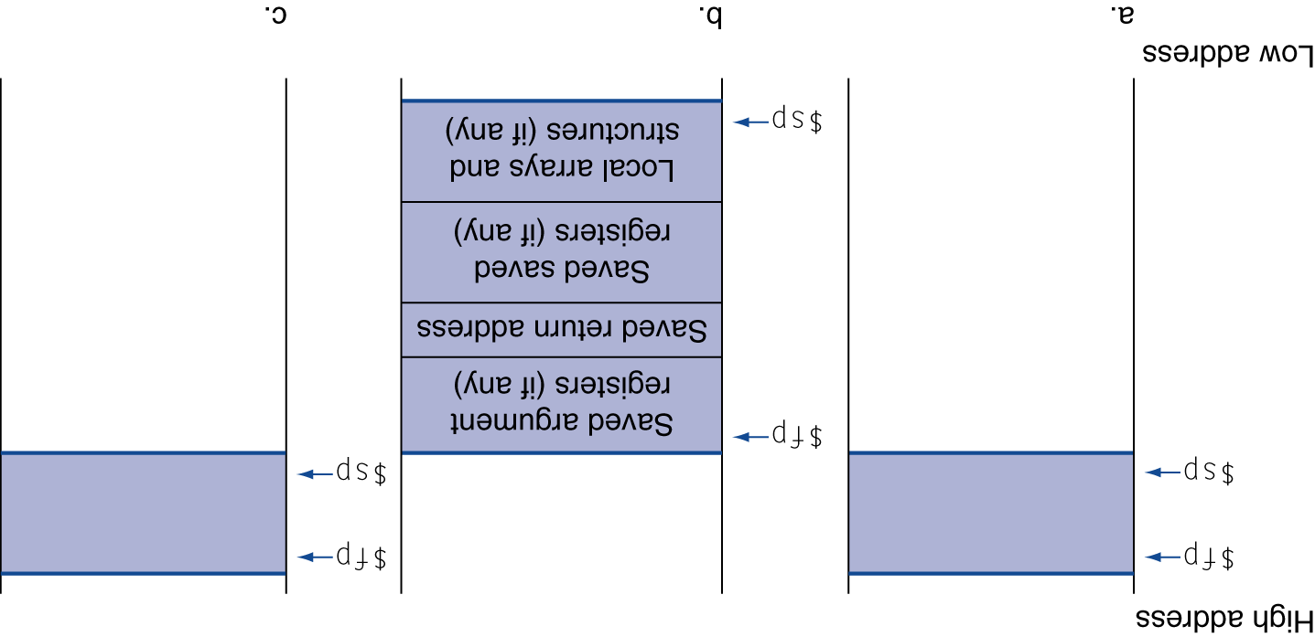
Local Data on the Stack
Low address
Before a call
During a call
After a call
←
$sp
Arguments and
other stuff
Return address
to caller
←
←
←
$sp
(reg 29)
$fp
$sp
$fp
←
←
$fp
(reg 30)
High address

Slide 65
Non-Leaf Procedure Example
MIPS code: Go over a small example to see its working
fact: # addi $sp, $sp, -8 # adjust stack for 2 items sw $ra, 4($sp) # save return address sw $a0, 0($sp) # save argument slti $t0, $a0, 1 # test for n < 1 beq $t0, $zero, L1 addi $v0, $zero, 1 # if so, result is 1 addi $sp, $sp, 8 # pop 2 items from stack jr $ra # and return L1: addi $a0, $a0, -1 # else decrement n jal fact # recursive call lw $a0, 0($sp) # restore original n lw $ra, 4($sp) # and return address addi $sp, $sp, 8 # pop 2 items from stack mul $v0, $a0, $v0 # multiply to get result jr $ra # and return
2000:
2040:

Slide 66
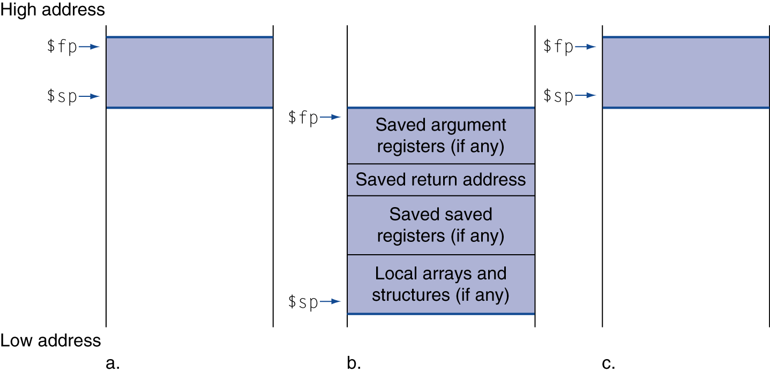
Local Data on the Stack
Local data allocated by callee
e.g., C automatic variables
Procedure frame (activation record)
Used by some compilers to manage stack storage

Slide 67
Non-Number Data
Byte-encoded character sets
ASCII: 128 characters (7 bits)
95 graphic, 33 control
Latin-1: 256 characters (8 bits)
ASCII, +96 more graphic characters
Unicode: 32-bit character set
Used in Java, C++ wide characters, …
Most of the world’s alphabets, plus symbols
UTF-8, UTF-16: variable-length encodings
§2.9 Communicating with People

Slide 68
Byte/Halfword Operations
MIPS can load and store byte/halfword
byte: 8-bit; halfword: 16-bit
Sign-extend to 32 bits in rt:
lb rt, offset(rs); lh rt, offset(rs)
Zero-extend to 32 bits in rt:
lbu rt, offset(rs); lhu rt, offset(rs)
Store just rightmost byte/halfword:
sb rt, offset(rs); sh rt, offset(rs)

Slide 69
String Copy Example
C code (naïve):
Null-terminated string
void strcpy (char x[], char y[]) { int i; i = 0; while ((x[i]=y[i])!='\0') i++; }
Addresses of x, y in $a0, $a1
i in $s0

Slide 70
String Copy Example
MIPS code:
strcpy: addi $sp, $sp, -4 # adjust stack for 1 item sw $s0, 0($sp) # save $s0 add $s0, $zero, $zero # i = 0 L1: add $t1, $s0, $a1 # addr of y[i] in $t1 lbu $t2, 0($t1) # $t2 = y[i] add $t3, $s0, $a0 # addr of x[i] in $t3 sb $t2, 0($t3) # x[i] = y[i] beq $t2, $zero, L2 # exit loop if y[i] == 0 addi $s0, $s0, 1 # i = i + 1 j L1 # next iteration of loop L2: lw $s0, 0($sp) # restore saved $s0 addi $sp, $sp, 4 # pop 1 item from stack jr $ra # and return

Slide 72
32-bit Constants
Most constants are small (a fact of life)
16-bit immediate is sufficient
For the (occasional) large 32-bit constant
lui rt, const # load upper-half
Copies 16-bit constant to left 16 bits of rt
Clears right 16 bits of rt to 0
§2.10 MIPS Addressing for 32-Bit Immediates and Addresses
61
lui $s0, 61
0000 0000 0011 1101 0000 0000 0000 0000
ori $s0, $s0, 2304
0000 0000 0011 1101 0000 1001 0000 0000
2304

Slide 73
Branch Addressing
Branch instructions specify
Opcode, two registers, target address
(Ex. beq $2, $3, L1)
Most branch targets are to a near target
Forward or backward
op
rs
rt
address (offset)
6 bits
5 bits
5 bits
16 bits

Slide 74
Branch Addressing
Branch instructions specify
Opcode, two registers, target address
(Ex. beq $2, $3, L1)
Most branch targets are to a near target
Forward or backward
?
op
rs
rt
address (offset)
6 bits
5 bits
5 bits
16 bits

Slide 75
Branch Addressing
Branch instructions specify
Opcode, two registers, target address
(Ex. beq $2, $3, L1)
Most branch targets are to a near target
Forward or backward
op
rs
rt
address (offset)
6 bits
5 bits
5 bits
16 bits
MIPS uses PC-relative addressing
Target address = PC + (offset × 4)
PC already incremented by 4 by this time

Slide 76
Jump Addressing
Jump (j and jal) targets could be anywhere in text segment
Encode full address in instruction
(Ex. j L2)
op
word-address
6 bits
26 bits
(Pseudo) Direct jump addressing
Target address = PC_{31…28} : (address × 4)

Slide 77
Target Addressing Example
Loop code from earlier example
Assume Loop at location 80000
Loop: sll $t1, $s3, 2 | 80000 | 0 | 0 | 19 | 9 | 2 | 0
add $t1, $t1, $s6 | 80004 | 0 | 9 | 22 | 9 | 0 | 32
lw $t0, 0($t1) | 80008 | 35 | 9 | 8 | 0
bne $t0, $s5, Exit | 80012 | 5 | 8 | 21 | 2
addi $s3, $s3, 1 | 80016 | 8 | 19 | 19 | 1
j Loop | 80020 | 2 | 20000
Exit: … | 80024

Slide 78
Branching Far Away
If branch target is too far to encode with 16-bit offset, assembler recompile the code
Example
beq $s0,$s1, L1 #if L1 > 16-bits
↓
bne $s0,$s1, L2 #L2 nearby addr j L1 #j instruction L2: … #holds larger addr

Slide 79
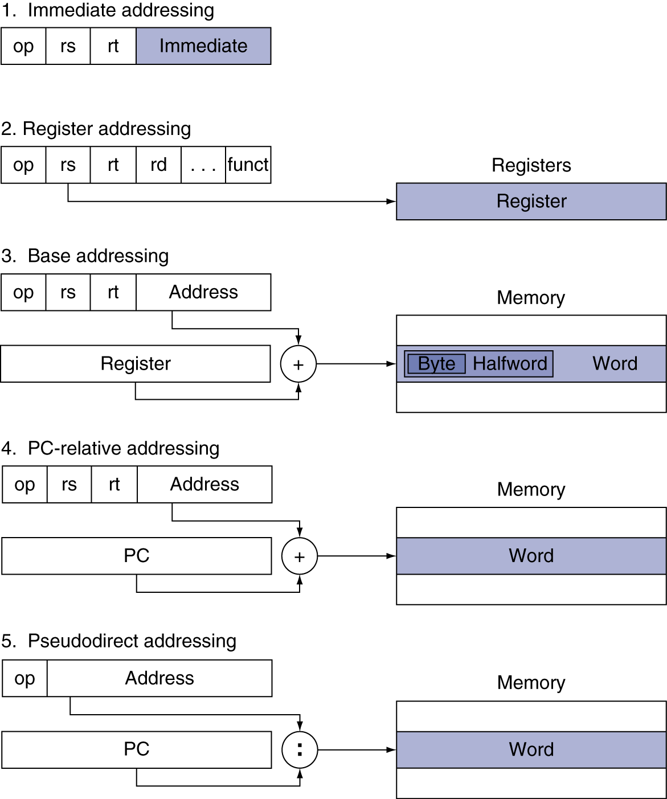
Summary: Addressing Mode
addi rs, rt, immed
add rd, rs, rt
lw rs, offset(rt)
beq rs, rt, L1
j L2

Slide 81
Synchronization
Two processors sharing an area of memory
P1 writes, then P2 reads
Data race if P1 and P2 don’t synchronize
Result depends of order of accesses
Hardware support required
Atomic read/write memory operation
No other access to the location allowed between the read and write
Could be a single instruction
E.g., atomic swap of register ↔ memory
Or an atomic pair of instructions
§2.11 Parallelism and Instructions: Synchronization

Slide 82
Synchronization in MIPS
Load linked: ll rt, offset(rs)
Store conditional: sc rt, offset(rs)
Succeeds if location not changed since the ll
Returns 1 in rt
Fails if location is changed
Returns 0 in rt
Example: atomic swap (to test/set lock variable)
try: add $t0,$zero,$s4 ;copy exchange value
ll $t1,0($s1) ;load linked
sc $t0,0($s1) ;store conditional
beq $t0,$zero,try ;branch store fails
add $s4,$zero,$t1 ;put load value in $s4

Slide 83
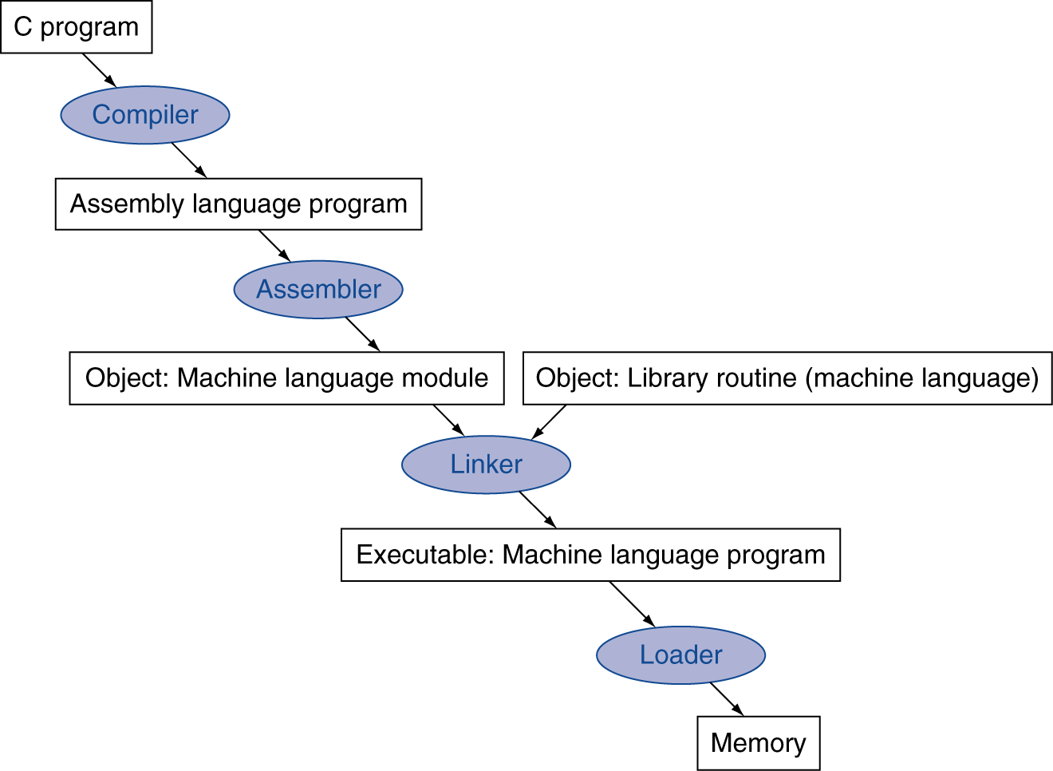
Translation and Startup
Many compilers produce object modules directly
§2.12 Translating and Starting a Program
Static linking

Slide 84
Assembler Pseudoinstructions
Most assembler instructions represent machine instructions one-to-one
Pseudoinstructions: of the assembler’s imagination
move $t0, $t1 → add $t0, $zero, $t1
blt $t0, $t1, L → slt $at, $t0, $t1 bne $at, $zero, L
$at (register 1): assemblfigmentser temporary

Slide 85
Producing an Object Module
Assembler (or compiler) translates program into machine instructions
Provides information for building a complete program from the pieces
Header: described contents of object module
Text segment: translated instructions
Static data segment: data allocated for the life of the program
Relocation info: for contents that depend on absolute location of loaded program
Symbol table: global definitions and external refs
Debug info: for associating with source code

Slide 86
Linking Object Modules
Produces an executable image
1. Merges segments
2. Resolve labels (determine their addresses)
3. Patch location-dependent and external refs
Could leave location dependencies for fixing by a relocating loader
But with virtual memory, no need to do this
Program can be loaded into absolute location in virtual memory space

Slide 87
Loading a Program
Load from image file on disk into memory
1. Read header to determine segment sizes
2. Create virtual address space
3. Copy text and initialized data into memory
Or set page table entries so they can be faulted in
4. Set up arguments on stack
5. Initialize registers (including $sp, $fp, $gp)
6. Jump to startup routine
Copies arguments to $a0, … and calls main
When main returns, do exit syscall

Slide 88
Dynamic Linking
Only link/load library procedure when it is called
Requires procedure code to be relocatable
Avoids image bloat caused by static linking of all (transitively) referenced libraries
Automatically picks up new library versions

Slide 89
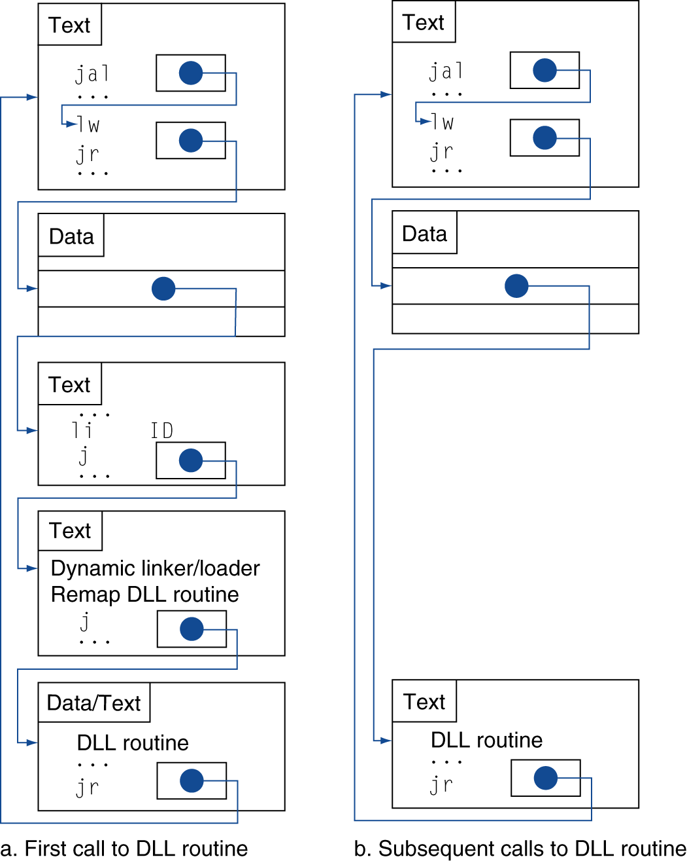
Lazy Linkage
Indirection table
Stub: Loads routine ID, Jump to linker/loader
Linker/loader code
Dynamically mapped code

Slide 90
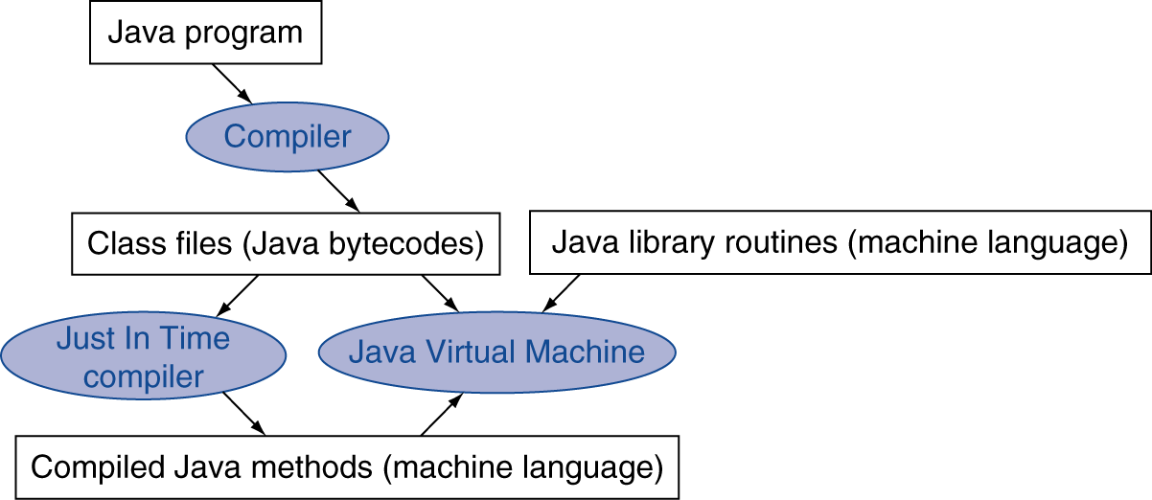
Starting Java Applications
Simple portable instruction set for the JVM
Compiles bytecodes of “hot” methods into native code for host machine
Interprets bytecodes

Slide 91
C Sort Example
Illustrates use of assembly instructions for a C bubble sort function
Swap procedure (leaf)
/* swap contents of v[k],v[k+1] */ void swap(int v[], int k) { int temp; temp = v[k]; v[k] = v[k+1]; v[k+1] = temp; }
v in $a0, k in $a1, temp in $t0
§2.13 A C Sort Example to Put It All Together

Slide 92
The Procedure Swap
swap: sll $t1, $a1, 2 # $t1 = k * 4
add $t1, $a0, $t1 # $t1 = v+(k*4)
# (address of v[k] in $t1)
lw $t0, 0($t1) # $t0 (temp) = v[k]
lw $t2, 4($t1) # $t2 = v[k+1]
sw $t2, 0($t1) # v[k] = $t2 (v[k+1])
sw $t0, 4($t1) # v[k+1] = $t0 (temp)
jr $ra # return to calling routine
Note: the stack is not used, because the procedure doesn’t use any registers whose content need to be reserved

Slide 93
The Sort Procedure in C
Non-leaf (calls swap)
void sort (int v[], int n)
{
int i, j;
for (i = 0; i < n; i += 1) {
for (j=i–1; j>=0 && v[j]>v[j+1]; j-=1){
swap(v,j); /*calls swap*/
}
}
}
v in $a0, k in $a1, i in $s0, j in $s1
Insertion Sort
Start comparing from left

Slide 94
The Sort Procedure in C
Non-leaf (calls swap)
void sort (int v[], int n)
{
int i, j;
for (i = 0; i < n; i += 1){
for (j = n–2; j >= i; j -= 1)
if (v[j]>v[j+1])
swap(v,j); /*calls swap*/
}
}
v in $a0, k in $a1, i in $s0, j in $s1
Bubble Sort
Start comparing from right

Slide 95
The Procedure Body
move $s2, $a0 # save $a0 into $s2
move $s3, $a1 # save $a1 into $s3
move $s0, $zero # i = 0
for1tst: slt $t0, $s0, $s3 # $t0 = 0 if $s0 ≥ $s3 (i ≥ n)
beq $t0, $zero, exit1 # go to exit1 if $s0 ≥ $s3 (i ≥ n)
addi $s1, $s0, –1 # j = i – 1
for2tst: slti $t0, $s1, 0 # $t0 = 1 if $s1 < 0 (j < 0)
bne $t0, $zero, exit2 # go to exit2 if $s1 < 0 (j < 0)
sll $t1, $s1, 2 # $t1 = j * 4
add $t2, $s2, $t1 # $t2 = v + (j * 4)
lw $t3, 0($t2) # $t3 = v[j]
lw $t4, 4($t2) # $t4 = v[j + 1]
slt $t0, $t4, $t3 # $t0 = 0 if $t4 ≥ $t3
beq $t0, $zero, exit2 # go to exit2 if $t4 ≥ $t3
move $a0, $s2 # 1st param of swap is v (old $a0)
move $a1, $s1 # 2nd param of swap is j
jal swap # call swap procedure
addi $s1, $s1, –1 # j –= 1
j for2tst # jump to test of inner loop
exit2: addi $s0, $s0, 1 # i += 1
j for1tst # jump to test of outer loop
Move params
Outer loop
Inner loop
Pass params & call
Inner loop
Outer loop

Slide 96
The Full Procedure
sort: addi $sp,$sp, –20 # make room on stack for 5 registers
sw $ra, 16($sp) # save $ra on stack
sw $s3,12($sp) # save $s3 on stack
sw $s2, 8($sp) # save $s2 on stack
sw $s1, 4($sp) # save $s1 on stack
sw $s0, 0($sp) # save $s0 on stack
… # procedure body
…
exit1: lw $s0, 0($sp) # restore $s0 from stack
lw $s1, 4($sp) # restore $s1 from stack
lw $s2, 8($sp) # restore $s2 from stack
lw $s3,12($sp) # restore $s3 from stack
lw $ra,16($sp) # restore $ra from stack
addi $sp,$sp, 20 # restore stack pointer
jr $ra # return to calling routine

Slide 97
Concluding Remarks
Principles for design of instruction set
1. Simplicity ⇒ regularity
2. Smaller ⇒ faster
3. Make the common case fast
4. Good design demands good compromises
§2.19 Concluding Remarks

Slide 98
Concluding Remarks
Measure MIPS instruction executions in benchmark programs
Consider making the common case fast
Consider compromises
Instruction class | MIPS examples | SPEC2006 Int | SPEC2006 FP
Arithmetic | add, sub, addi | 16% | 48%
Data transfer | lw, sw, lb, lbu, lh, lhu, sb, lui | 35% | 36%
Logical | and, or, nor, andi, ori, sll, srl | 12% | 4%
Cond. Branch | beq, bne, slt, slti, sltiu | 34% | 8%
Jump | j, jr, jal | 2% | 0%

